Slide 1
Detection of Ocular disease using Transfer and Federated Learning
Group No : 27
CSE 707
By
23366010 Bushra Rafia Chowdhury
23366028 Sadia Tasnim
23366032 Labib Hasan Khan
CSE 707 Course Instructor
Mr. Annajiat Alim Rasel
Senior Lecturer, Department of CSE
BRAC University
ST - Mehnaz Ara Fazal
RA - Md Sabbir Hossain

Slide 2
Outline
Introduction
Problem Statement
Motivation
Dataset
Overall Architecture
Model Comparison
Transfer Learning
Hyper parameter used
Result analysis
Limitation
Future Work

Slide 3
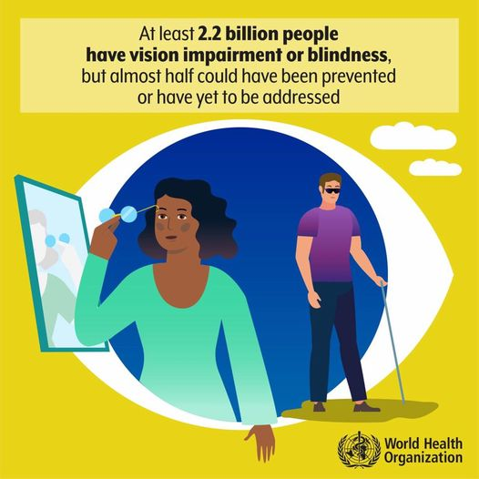
Introduction

Slide 4
Problem Statement
Motivation
Automated methods may lack accuracy, requiring human validation.
Concerns about patient confidentiality and privacy.
Limited availability of diverse datasets for ocular diseases.
Rapid and automatic detection of ocular diseases
Reducing the ophthalmologist’s workload
Prevents vision damage of patients.

Slide 5
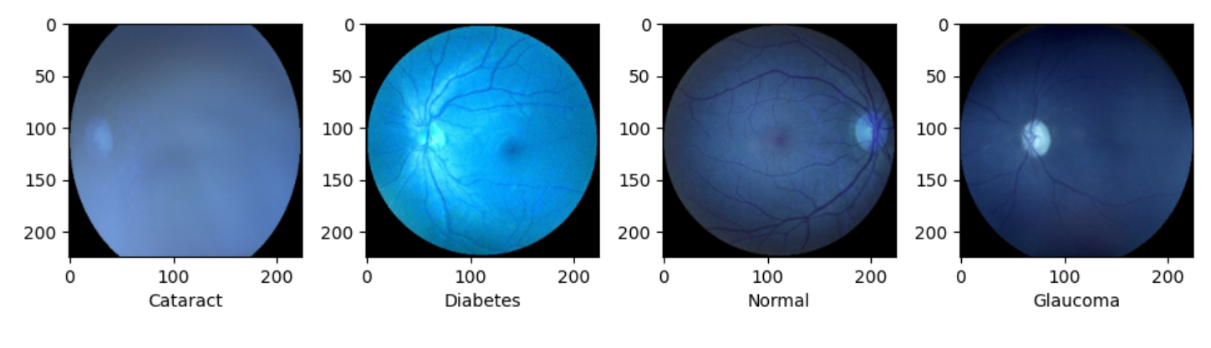
Dataset
ODIR (Ocular Disease Intelligent Recognition) 2019
A structured ophthalmic database of around 5000 patients from China
Contains: Age , Color fundus photographs of both eyes & Diagnostic keywords from doctors.
Categories: normal (N), diabetes (D), cataract (C), glaucoma (G)
Figure : Sample Images from Dataset

Slide 6
Dataset Class Distribution
Type | Class Size | Encoded Label
Normal | 2873 | 0
Cataract | 293 | 1
Diabetes | 1608 | 2
Glaucoma | 284 | 3

Slide 7
Overall Architecture
Dataset Augmentation
Manually encode labels
Train-validation-Test
Federated Average
Transfer Learning Architecture

Slide 8
Model Comparison
Model Name | Accuracy (%) | Time elapsed
EffecientNet V2 | 78.12 | 161.3s
EffecientNet V1 | 76.21 | 60.6s
MobileNet V2 | 72.23 | 164.5 s
Resnet50V2 | 66.51 | 164.7
Inception V3 | 65.73 | 163.6s

Slide 9
EfficientNetV2B1
Included Fused-MBConv new convolutional blocks
Combined MBConv and simpler 3x3 convolutions
Has 8.2 million parameters
Higher accuracy

Slide 10
Transfer Learning
Reusing a pretrained model on a different dataset
Adding new layers on top of the existing model
EfficientNet model was pre-trained on imagenet dataset.

Slide 11
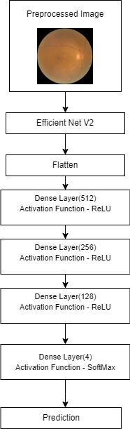
Transfer Learning Model Architecture
EfficientNet V2 B1
Flatten Layer
3 Dense Layer
1 output layer with softmax function
4 probable outputs
Figure : Model Architecture

Slide 12
Model Hyperparameters
Hyper Parameters | Value
Epoch | 20
Batch Size | 32
Loss function | sparse categorical cross_entropy_loss
Optimizer | Adam
Pooling Layer | Max

Slide 13
Result Analysis
Epoch | Accuracy
1 | 65.60
4 | 78.30
7 | 90.11
10 | 93.16
13 | 94.53
17 | 95.93
20 | 95.58

Slide 14
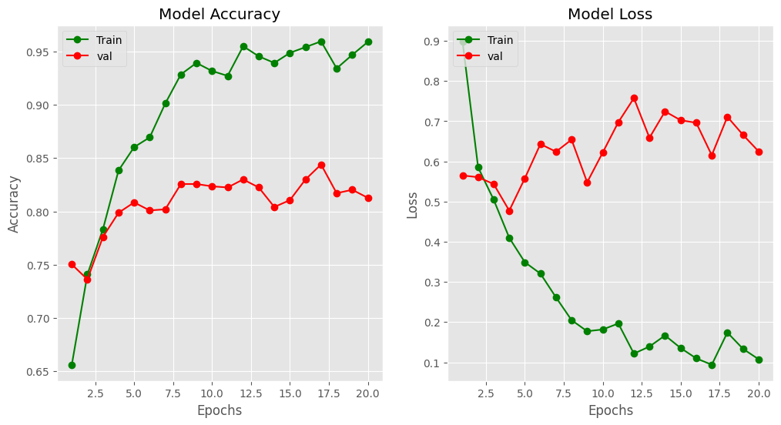
Result Analysis

Slide 15
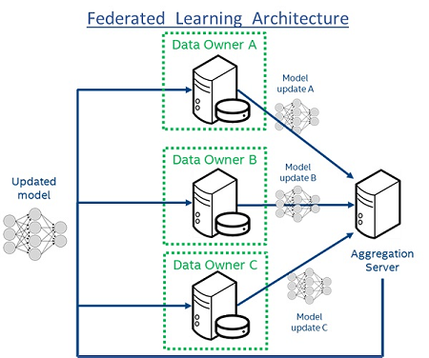
Federated Learning

Slide 16
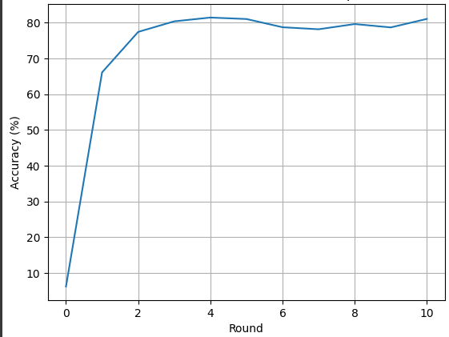
Federated Average Performance

Slide 17
Limitation
Medical dataset is private
Data cleaning & labeling
Compute and bandwidth availability

Slide 18
Future Work
XAI
Ensemble Learning
Application

Slide 19
Thank You

